Slide 1

API’s Application Programing Interfaces
Matt Morais

Slide 2

What it is
API = Application Programming Interface
Provides a series of functions, methods, and classes that allow two systems to communicate
A software interface
Web APIs
Communication between computer and internet

Slide 3
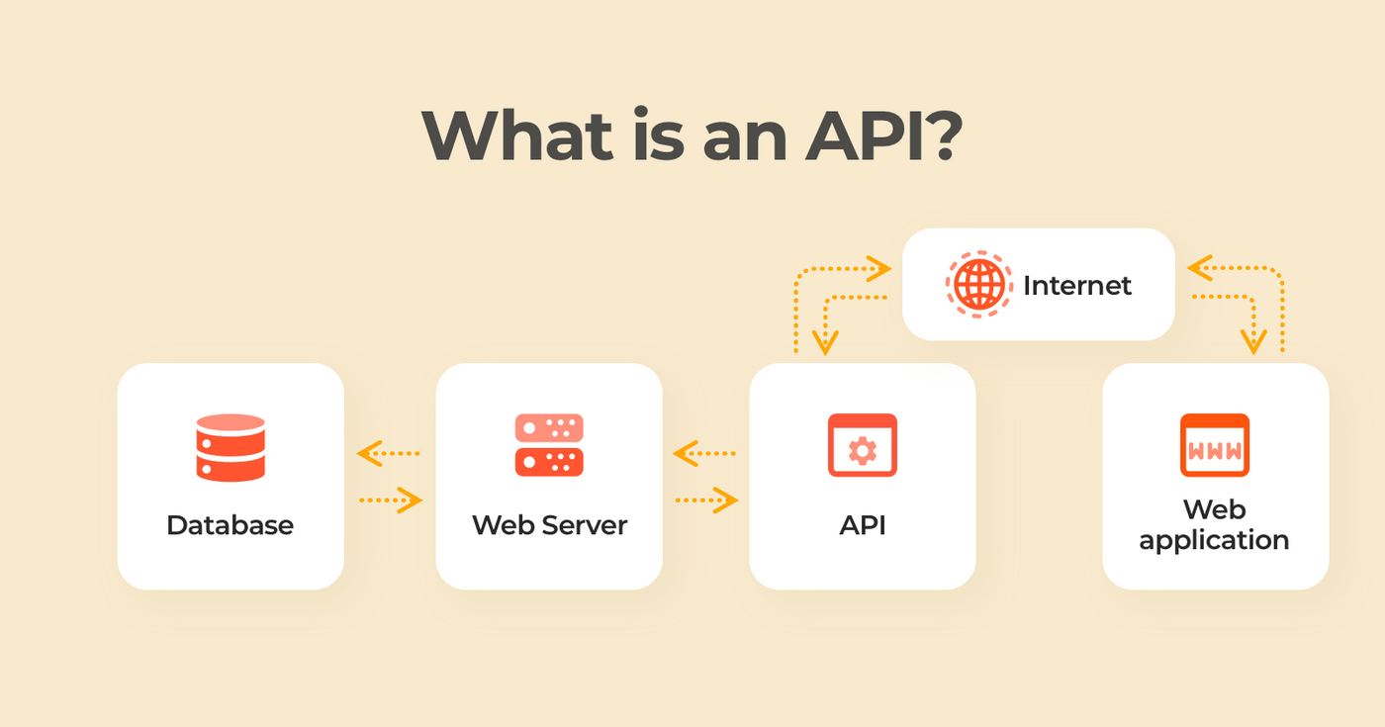

What it does
Example Web API
Abstract inner workings from utility
Only exposes the functions/methods needed for the developer
Simplifies how applications access data
Allows your application to be easily extended

Slide 4
Types of API’s
Open
Open source, no restrictions
Partner
Require licenses
Internal
Private, developed by companies for internal use only
Composite
Combine different data and services
This presentation’s focus

Slide 5

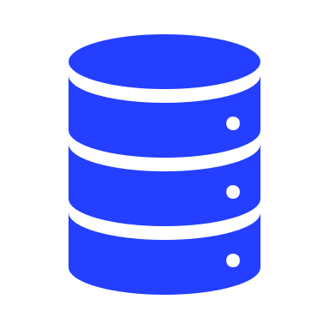

Types of API’s continued
Local API’s
Operating System to Application
This presentation’s focus
Web API’s
Internet to Application
Program API’s
Remote program appears local

Slide 6
Web API’s
Server Side
Back-end development
Code runs on server
Web apps, connecting website to database, security
Languages: Java, Python, SQL
Client Side
Front-end development
Code runs locally
Layouts, UIs, form validation
Languages: Javascript, HTML
This presentation’s focus

Slide 7
Where it can be used
Defense Industry
Seekers
Embedded Software Defined Radios
Commercial
Raspberry Pi (simplified GPIO programming)
Cloud Computing (google cloud, AWS)
Anywhere… that has software
Pretty much any piece of code that is designed to be extendable or developed further by others

Slide 8
Demo Time!
Spotify
Create Spotify App
Add Developers
Setup Redirect URIs
Python
Create Python Virtual Environment
Launch Jupyter notebook
Develop
Check user credentials
Create a new playlist
Add a few songs to it
Check the registered devices
Play that playlist on the user device
Create a new playlist
Learn about search and look up functions

Slide 9



Summary
What an API is, and its purpose
The different types of APIs
How to create an App that utilizes an existing API

Slide 10




Thank you
Matt Morais
mmorais1@depaul.edu

